Slide 1
8.1 Programming
Variables and constants

Slide 2


What is a variable?
Central Processing Unit (CPU)
Main Memory (RAM)
The memory address register (MAR) contains the address of an instruction or data to be fetched from or written to main memory.
In a similar way, a variable is nothing more than a pointer to a memory address with a user-friendly label.
Control
Unit
(CU)
Arithmetic Logic Unit (ALU)
Address | Data
1 | Load address 5
2 | Add address 6
3 | Store in address 6
4 | End
5 | 23
6 | 12
Register
Memory Address Register (MAR)
Cache
Clock

Slide 3
What is a variable?
You can think of a variable like a tin can in that it holds data but is only really useful if it is labelled.
firstName
Age
dateOfBirth

Slide 4


What is a variable?
In most programming languages you must declare variables before they can be used. In other words, you must get a can and label it before you can put something in it.
At the point you declare a variable, it holds nothing. Not zero, not an empty string, nothing. In programming, we call this null.
firstName
Age
dateOfBirth
One of the most popular languages used to teach programming is Python. Python does not require you to declare variables before you use them.
However, in the exam, you are expected to know about this, so take care.

Slide 5
What is a variable?
27
Once you have declared a variable, you can then assign a value to it – this is like putting an item into the can.
“Sam”
23/03/89
firstName
Age
dateOfBirth
The contents of the firstName variable holds the value “Sam”.
The contents of the Age variable holds the value 27.
The contents of the dateOfBirth variable holds the value 23/03/89

Slide 6
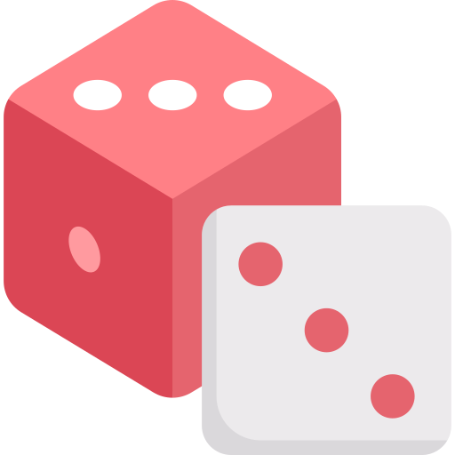
Beat the Dice
Beat the Dice is a simple game to help young children learning to compare one- and two-digit numbers:
Players roll two dice.
Doubles do not count and must be rolled again.
The score is the value of the highest and lowest dice combined, highest first (e.g., 5 and 7 = 75).

Slide 7
#Beat the Dice
#Import libraries
import random
#Constants
rolls_per_player = 2
#Initialise varilables
total = 0
#Roll the dice
for rolls in range(rolls_per_player):
dice1 = 0
dice2 = 0
#Handle the possibility of a double throw
while dice == dice2:
dice1 = random.randint(1,6)
dice2 = random.randint(1,6)
#Output the dice
print("dice 1:",dice1)
print("dice 2:",dice2)
#Cast the dice values from integers to strings ready for changing the order of the dice
dice1_string = str(dice1)
dice2_string = str(dice2)
#Change the order of the dice to the highest value first and join the values together
if dice1 > dice2:
roll_value = dice1_string + dice2_string
else:
roll_value = dice2_string + dice1_string
#Cast the value of the dice back to an integers for adding the score to the total
roll_value = int(roll_value)
#Ask for the value of the roll
user_input = int(input("What is the value of the roll?"))
#Output the value of the dice
if user_input == roll_value:
print("You worked it out correctly.")
else:
print("No, the value of the roll is:",roll_value)
#Add the value of the dice to the total
total = total + roll_value
#Output the total score of the rolls
print("The total of the",rolls_per_player,"rolls is:", total)

Slide 8
#Beat the Dice
#Import libraries
import random
#Constants
rolls_per_player = 2
#Initialise varilables
total = 0
#Roll the dice
for rolls in range(rolls_per_player):
dice1 = 0
dice2 = 0
#Handle the possibility of a double throw
while dice == dice2:
dice1 = random.randint(1,6)
dice2 = random.randint(1,6)
#Output the dice
print("dice 1:",dice1)
print("dice 2:",dice2)
#Cast the dice values from integers to strings ready for changing the order of the dice
dice1_string = str(dice1)
dice2_string = str(dice2)
#Change the order of the dice to the highest value first and join the values together
if dice1 > dice2:
roll_value = dice1_string + dice2_string
else:
roll_value = dice2_string + dice1_string
#Cast the value of the dice back to an integers for adding the score to the total
roll_value = int(roll_value)
#Ask for the value of the roll
user_input = int(input("What is the value of the roll?"))
#Output the value of the dice
if user_input == roll_value:
print("You worked it out correctly.")
else:
print("No, the value of the roll is:",roll_value)
#Add the value of the dice to the total
total = total + roll_value
#Output the total score of the rolls
print("The total of the",rolls_per_player,"rolls is:", total)
#Initialise varilables
total = 0
A variable is a value that can change while a program is running – it is simply an address in memory.
#Add the value of the dice to the total
total = total + roll_value

Slide 9
#Beat the Dice
#Import libraries
import random
#Constants
rolls_per_player = 2
#Initialise varilables
total = 0
#Roll the dice
for rolls in range(rolls_per_player):
dice1 = 0
dice2 = 0
#Handle the possibility of a double throw
while dice == dice2:
dice1 = random.randint(1,6)
dice2 = random.randint(1,6)
#Output the dice
print("dice 1:",dice1)
print("dice 2:",dice2)
#Cast the dice values from integers to strings ready for changing the order of the dice
dice1_string = str(dice1)
dice2_string = str(dice2)
#Change the order of the dice to the highest value first and join the values together
if dice1 > dice2:
roll_value = dice1_string + dice2_string
else:
roll_value = dice2_string + dice1_string
#Cast the value of the dice back to an integers for adding the score to the total
roll_value = int(roll_value)
#Ask for the value of the roll
user_input = int(input("What is the value of the roll?"))
#Output the value of the dice
if user_input == roll_value:
print("You worked it out correctly.")
else:
print("No, the value of the roll is:",roll_value)
#Add the value of the dice to the total
total = total + roll_value
#Output the total score of the rolls
print("The total of the",rolls_per_player,"rolls is:", total)
#Constants
rolls_per_player = 2
A constant is a value that remains fixed throughout – it must be set when the program is first written.

Slide 10
#Beat the Dice
#Import libraries
import random
#Constants
rolls_per_player = 2
#Initialise varilables
total = 0
#Roll the dice
for rolls in range(rolls_per_player):
dice1 = 0
dice2 = 0
#Handle the possibility of a double throw
while dice == dice2:
dice1 = random.randint(1,6)
dice2 = random.randint(1,6)
#Output the dice
print("dice 1:",dice1)
print("dice 2:",dice2)
#Cast the dice values from integers to strings ready for changing the order of the dice
dice1_string = str(dice1)
dice2_string = str(dice2)
#Change the order of the dice to the highest value first and join the values together
if dice1 > dice2:
roll_value = dice1_string + dice2_string
else:
roll_value = dice2_string + dice1_string
#Cast the value of the dice back to an integers for adding the score to the total
roll_value = int(roll_value)
#Ask for the value of the roll
user_input = int(input("What is the value of the roll?"))
#Output the value of the dice
if user_input == roll_value:
print("You worked it out correctly.")
else:
print("No, the value of the roll is:",roll_value)
#Add the value of the dice to the total
total = total + roll_value
#Output the total score of the rolls
print("The total of the",rolls_per_player,"rolls is:", total)
#Constants
rolls_per_player = 2
#Initialise varilables
total = 0
Assignment is when we supply a value to a variable or constant, performed with the = symbol.

Slide 11
Cambridge IGCSE pseudocode
Here is an example of how these concepts will look in exam papers following the Cambridge IGCSE pseudocode format, which is listed towards the back of the syllabus.
CONSTANT <identifier> ß <value>
CONSTANT HourlyRate ß 12.50
CONSTANT DefaultText ß "NA"
CONSTANT MaxScore ß 99999
DECLARE <identifier> : <data type>
DECLARE Counter : INTEGER
DECALRE TotalToPay: REAL
DECLARE GameOver : BOOLEAN
Constants
Variables

Slide 12

Variables and constants
Variable: A value stored in memory that can change while the program is running – can be an integer, character, string, real/float or Boolean value.
Constant: A value that is assigned when the program is first written and does not change while it is running.
Constants make a program easier to read, as they are usually declared and assigned at the top of the program.
They allow programmers to modify a program by changing one value rather than having to change every instance of a value throughout the program, reducing the possibility of errors.
If constants are used instead of variables, a compiler can be used to optimise code, making the program run faster.

Slide 13


